Slide 1
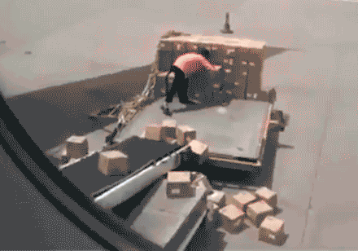
LanCo Catalogue Sales

Slide 2
The Problem of Returned Merchandise
LanCo Catalogue Sales rely on Cash-On-Delivery transactions but has recently been experiencing a high level of product returns. This has consequently resulted in significantly reduced company sales revenue and overall net income.
To address this issue, we aim to assess the magnitude of returns, identify contributing factors, and develop contingency plans to remediate the net loss.

Slide 3
Objectives
Utilizing sample of sales data, our objective is to determine the underlying patterns pertaining to returns.
Once the pattern has been attributed to a specific cause, the goal is to provide recommendations to reduce the number of returns.
The main endpoint is to improve the net income.

Slide 4
Key Assumptions
Each order is shipped as a single package.
The transit time between the package leaving the company and arriving at the customer’s home is constant for all deliveries.
Every return in the samples represent unclaimed returns.
Each order contributes equally to net profit.

Slide 5
The average processing days not returned is lower than the average processing days returned.
T-test average processing days – p= .0056
There is a statistical difference between the means of returned and non returned orders.

Slide 6
The average order size not returned is lower than the average order size returned.
T-test average processing days – p= .0024
There is a statistical difference between the means of order size not returned and order size returned.

Slide 7
As order size increases, probability of returns increases.
This is most likely due to changes in customer’s financial situation as they receive the order.

Slide 8
As shipment days increases, probability of returns increases.
This is most likely due to changes in customer’s demand for the product as time increases. They might have also bought the product if it was needed in a more timely fashion.

Slide 9
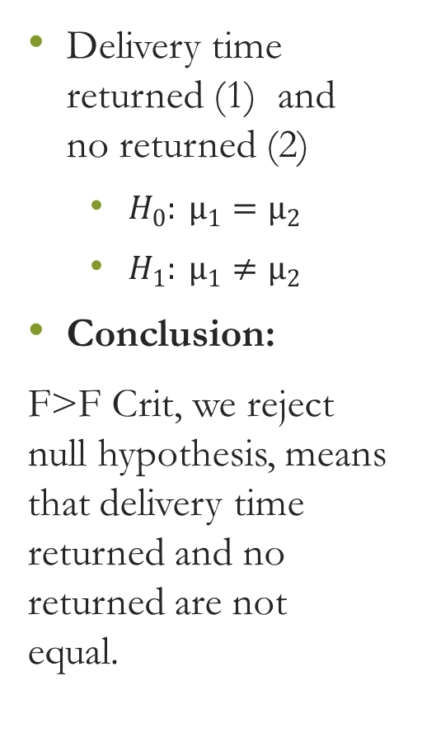
Delivery time returned (1) and no returned (2)
$H_{0}: µ_{1}=µ_{2}$
$H_{1}: µ_{1}≠µ_{2}$
Conclusion:
F>F Crit, we reject null hypothesis, means that delivery time returned and no returned are not equal.
Anova: Single Factor
SUMMARY (Delivery Time)
Groups | Count | Sum | Average | Variance
Delivery Time (No) | 56 | 383 | 6.839286 | 24.46461
Delivery Time (Yes) | 19 | 202 | 10.63158 | 26.91228
ANOVA
Source of Variation | SS | df | MS | F | P-value | F crit
Between Groups | 204.0254 | 1 | 204.0254 | 8.13883 | 0.005633 | 3.972038
Within Groups | 1829.975 | 73 | 25.06815
Total | 2034 | 74

Slide 10
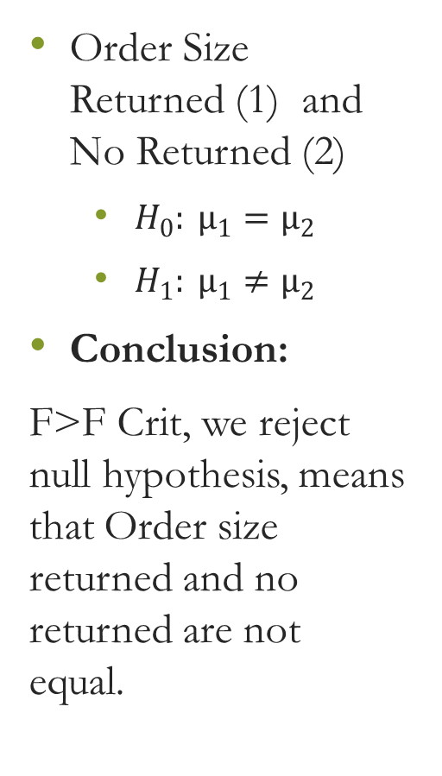
Order Size Returned (1) and No Returned (2)
$H_{0}: µ_{1}=µ_{2}$
$H_{1}: µ_{1}≠µ_{2}$
Conclusion:
F>F Crit, we reject null hypothesis, means that Order size returned and no returned are not equal.
SUMMARY (Order Size)
Groups | Count | Sum | Average | Variance
Order Size ($) (No) | 56 | 5058 | 90.32143 | 2164.768
Order Size ($) (Yes) | 19 | 2484 | 130.7368 | 2848.871
ANOVA
Source of Variation | SS | df | MS | F | P-value | F crit
Between Groups | 23172.58 | 1 | 23172.58 | 9.930607 | 0.002358 | 3.972038
Within Groups | 170341.9 | 73 | 2333.451
Total | 193514.5 | 74

Slide 11
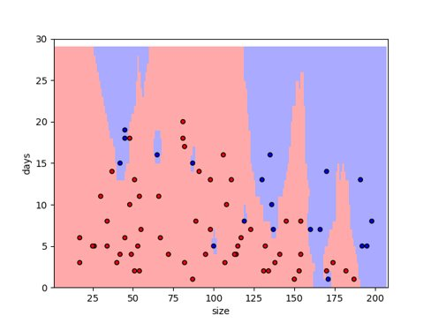
k -NearestNeighbors Classification​
Not Returned
Returned

Slide 12
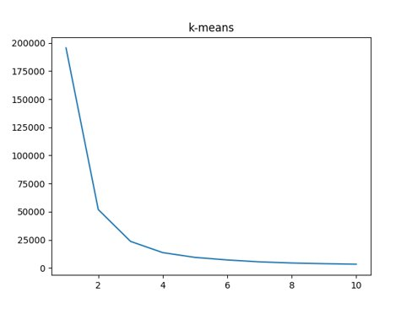
Find K (Elbow Point)
K value =3

Slide 13
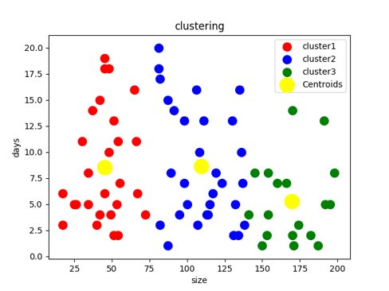
kMean

Slide 14
Recommendations
Rent/purchase ware houses (By considering these factors)
Region
Sale
Returns
Size
Initiate “rush handling” in warehouses to expedite orders of big size to 3 days or less. This process will increase operating costs but will reduce the return probability significantly.
This is limited for extremely large order sizes since the customer will be more likely to return these orders regardless of handling time.
Reduce overall order size
Separate orders into smaller easily affordable shipments

Slide 15
Possible Outcomes
Delivery on time
Cost effective
Time of return of product to office is less as compared to the prior scenario which was minimum( 5 weeks) -> out dated/out fashioned
Don’t have to sale the product on discount.
More number of promotions
More customers are attracted
Example: Amazon

Slide 16
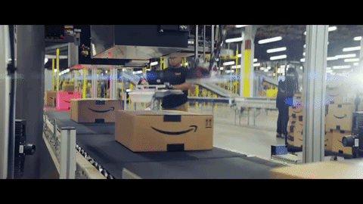
Thank You!

